Slide 1
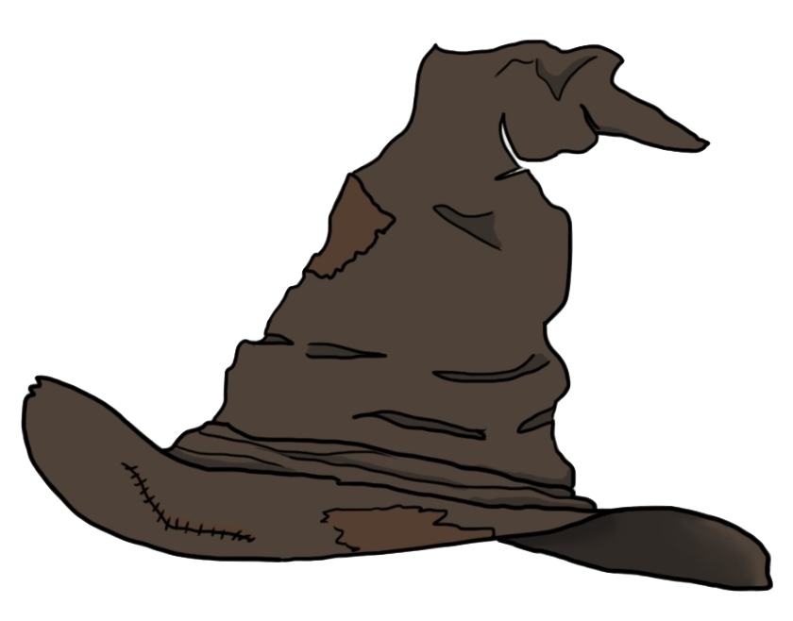
Sorting Hat
By: Caitlin Sizemore

Slide 2
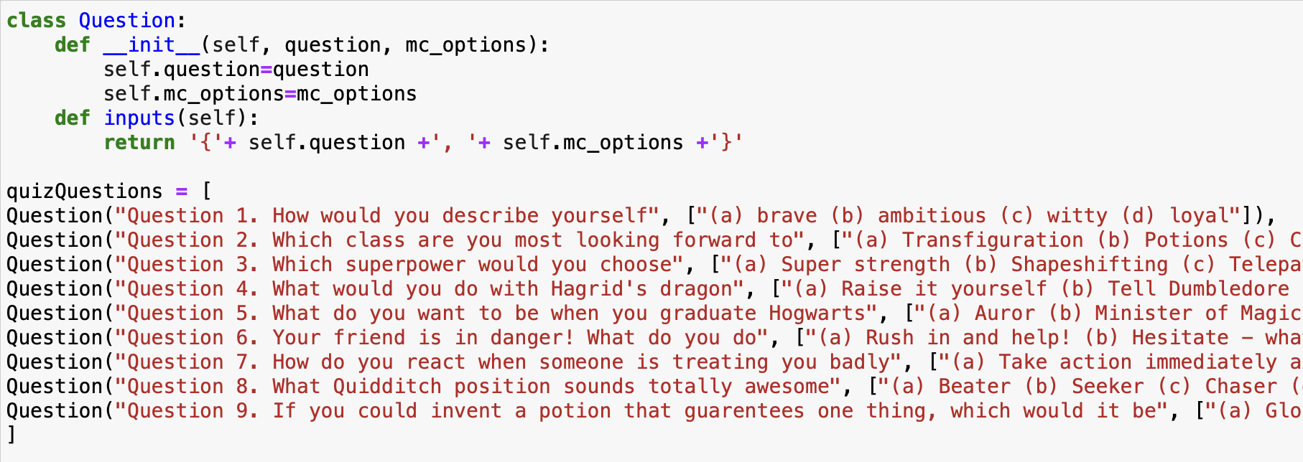

Setup
Questions
1.
2.
3.
4.
5.
Class Question holds the question and its potential answers
quizQuestions calls the class for each question in the list

Slide 3
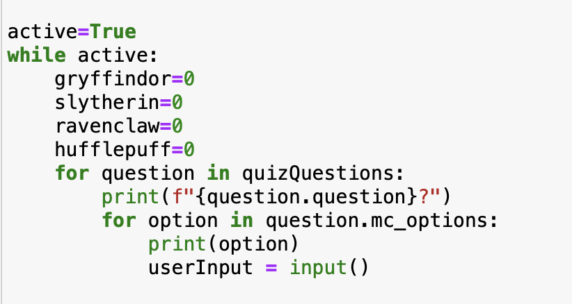
Running Quiz
While loop runs the quiz
Class is already called through the list
For – prints the question and its options
Each house is set to 0 initially

Slide 4
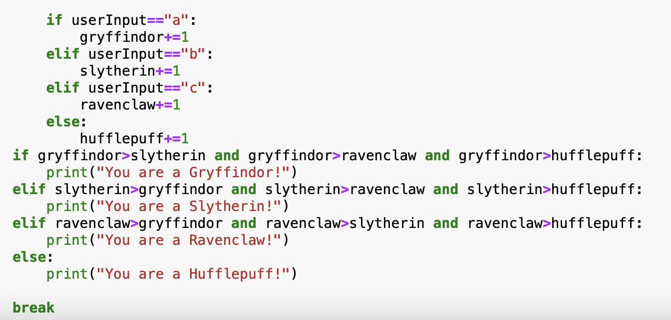
Scoring
You are…
Each letter option adds a value to one of the four houses
Sorting is based upon whichever house holds the most points

Slide 5
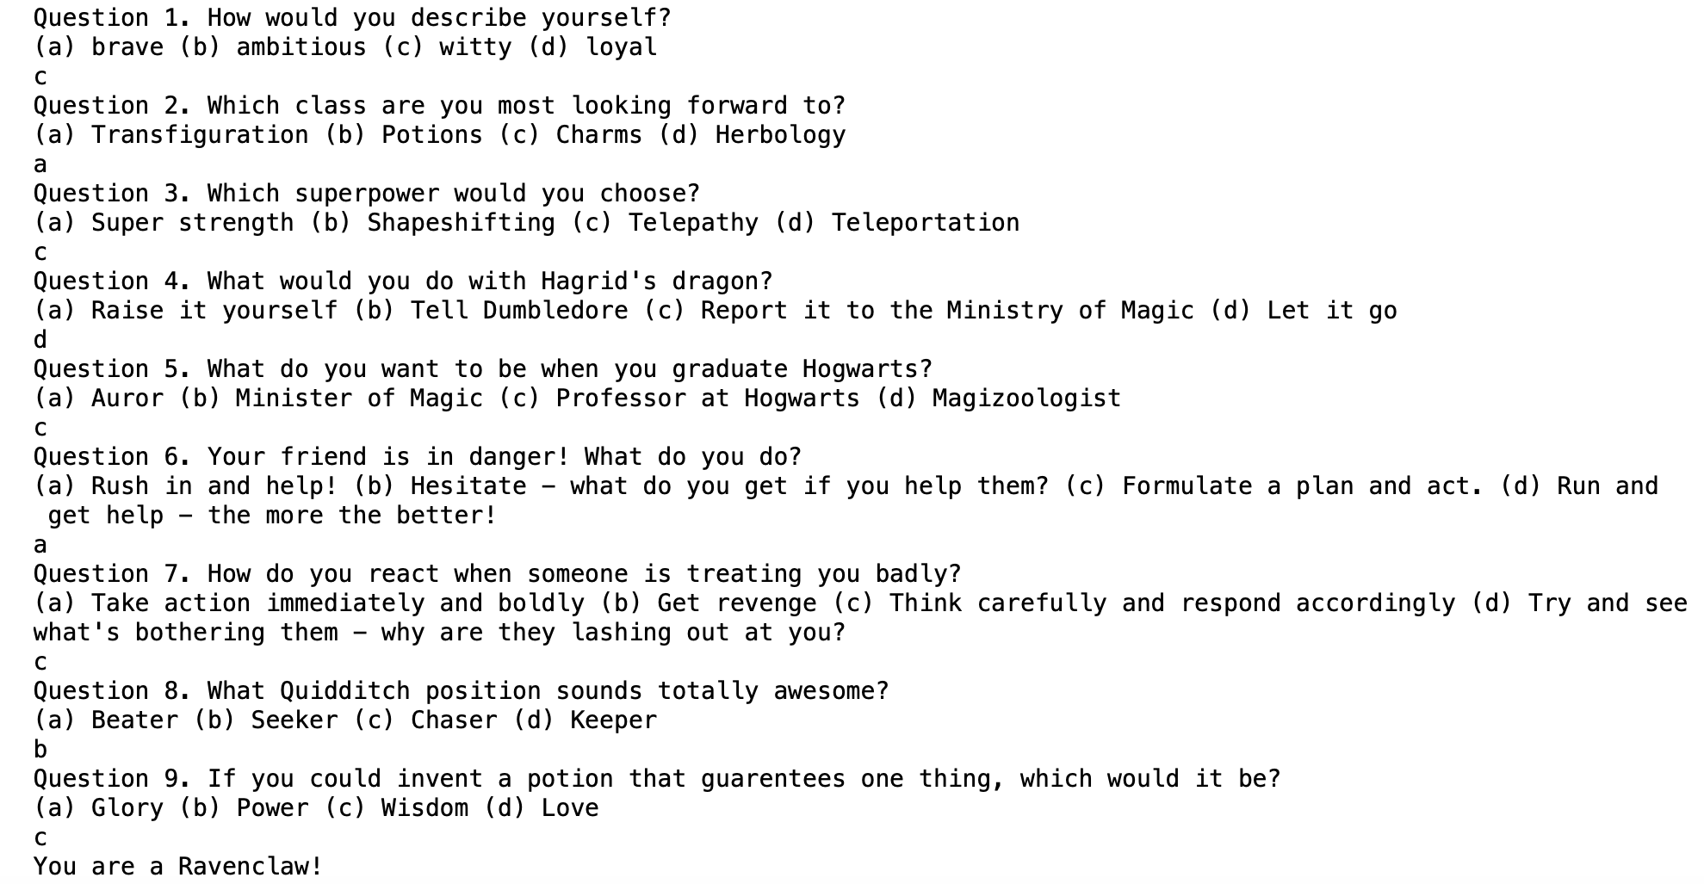

Outcomes

